Slide 1


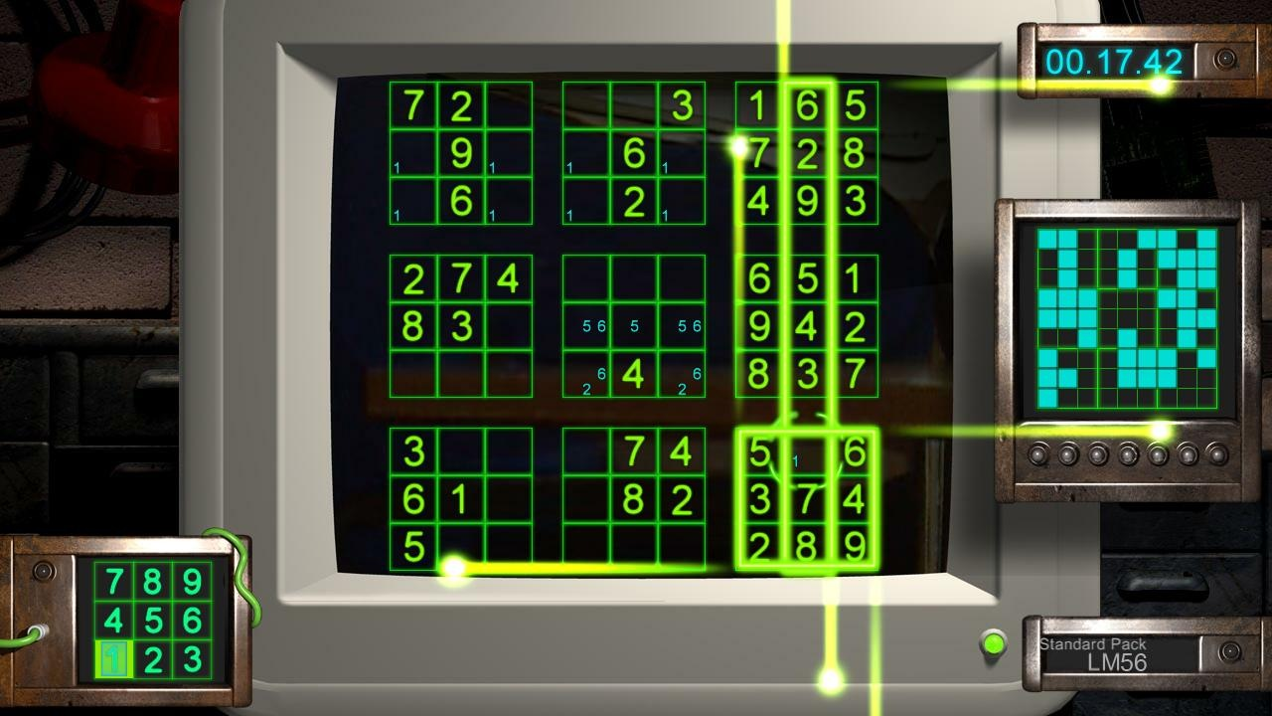
Daffodil Int. University
PROJECT PRESENTATION
AI SUDOKU SOLVER
The Mortals

Slide 2




TEAM OVERVIEW
Sayem Al Mahadi
Farhana Smritee
Robayet Hossain Niloy
Ahmed Zubayer Sunny
191-15-12949
191-15-12467
191-15-12944
191-15-12960

Slide 3
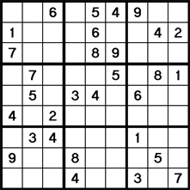
What is sudoku?
Sudoku is a puzzle game designed for a single player, much like a crossword puzzle. The puzzle itself is nothing more than a grid of little boxes called “cells”. They are stacked nine high and nine wide, making 81 cells total. The puzzle comes with some of the cells (usually less than half of them) already filled in, like this:
Each little square is called a "cell." Most often, Sudoku cells are filled with numbers (1-2-3-4-5-6-7-8-9), but sometimes pictures or Japanese symbols are used instead.

Slide 4
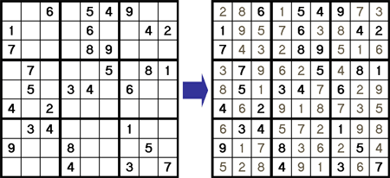
Sudoku Rules & Object of the game
The object of the game is simple: Fill in the empty cells!
Easy, right? Well, hang on a sec...there is one rule you must follow: no repeats are allowed in any row, column, or block. To put it another way - you must use all nine numbers in each row, column, and block.

Slide 5
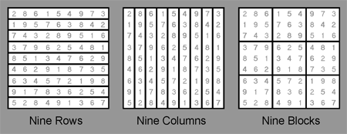
OK, so what are rows, columns, and blocks? Glad you asked! Take a look at this diagram:
Here we see the same puzzle shown three different ways, in order to highlight the rows, columns, and blocks. Together, I refer to these as the 27 'houses'.

Slide 6



Project Materials

Slide 7
Here are some topics we covered for ours project
1.What is the backtracking method.
2.How to use recursion in programming.
3.How to solve Sudoku using recursion in Python

Slide 8


Steps
First of all we make a parent class –
Then make a method for set the empty sells to 0 –

Slide 9
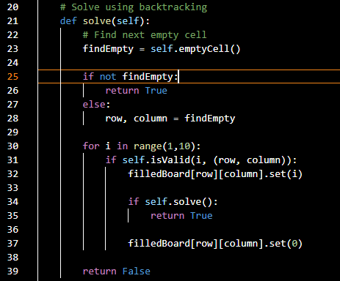
Using Backtracking Method for find the next empty sell

Slide 10
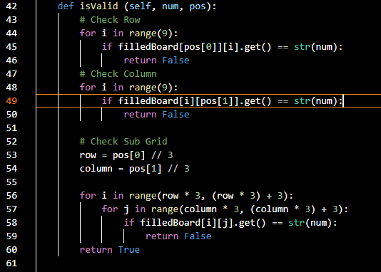
Now make a “isValid” method for Check row, column and subgrid(3x3 square) to see if number can be placed in
Cell!!

Slide 11
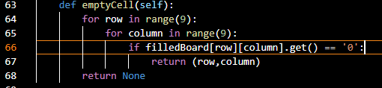
Next Make a “emptyCell” Method to Find empty cells,
defined as cells
filled with a zero!

Slide 12
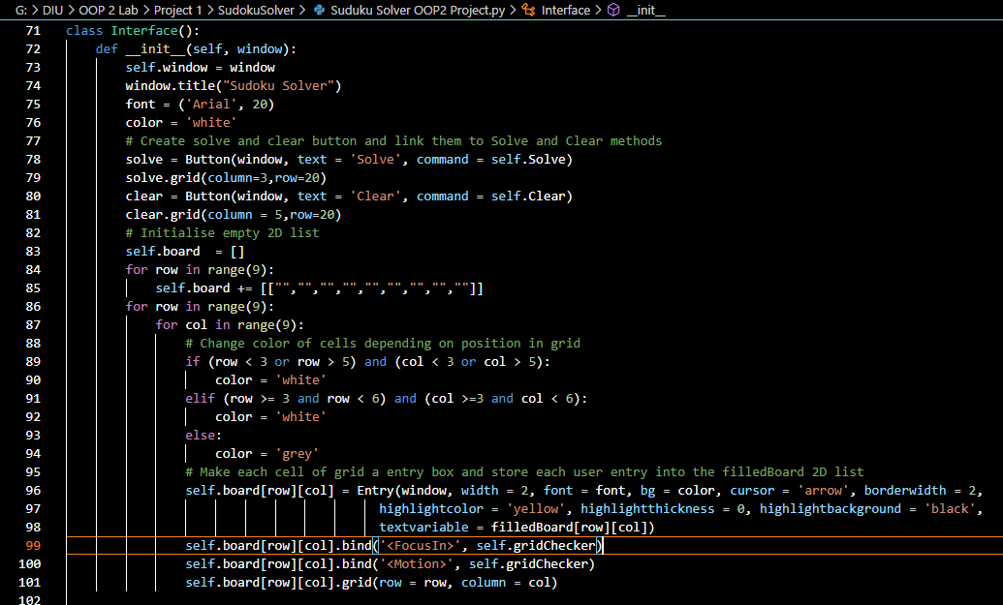
GUI Class “Class Interface”

Slide 13
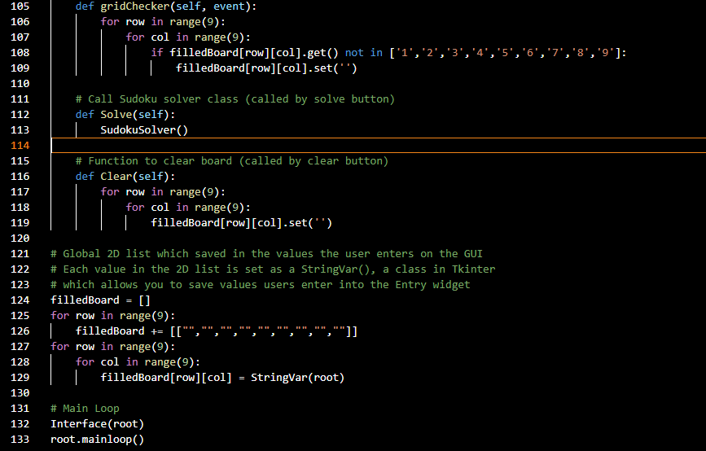
Function to check if user enters a value which is not an int between 1 and 9
(valid numbers in Sudoku game)

Slide 14
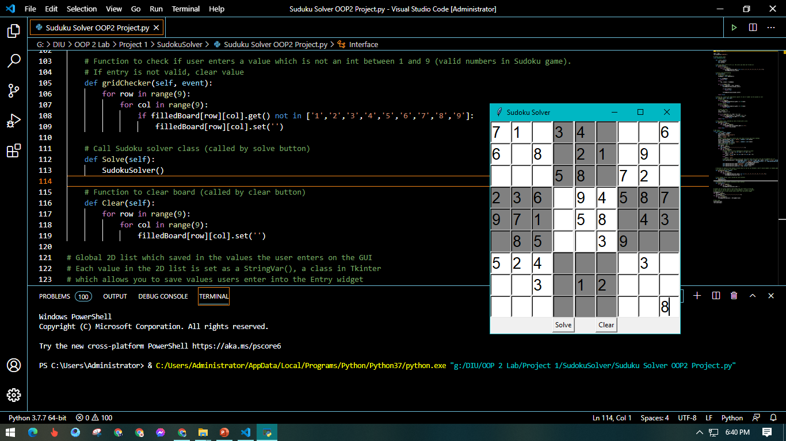

Slide 15
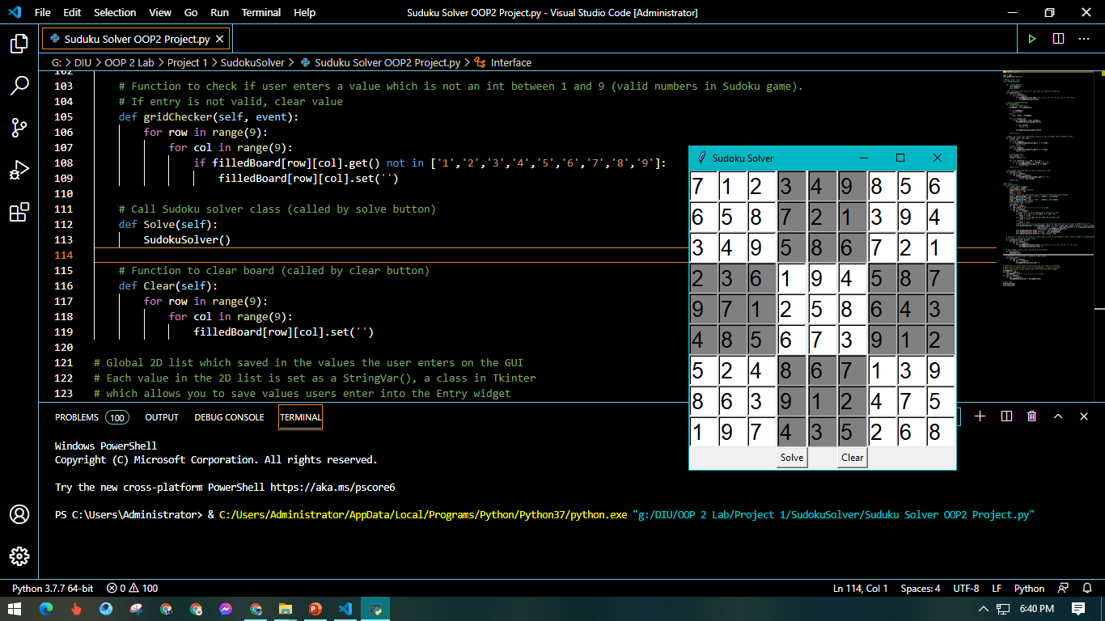

Slide 16


